Slide 1

MSC. DATA SCIENCE AND BUSINESS ANALYTICS
STOCK MARKET ANALYSIS

Slide 2
Topic: Stock Market Analysis
Problem Statement: Analysis and prediction of Stock Market prices of Vodafone Idea and Bharti Airtel
Objective of the Analysis: To perform a comparative analysis of two companies stock prices and their causes
Tools Used: Python(Jupyter)
Stock Market Analysis – Vodafone Idea and Bharti Airtel

Slide 3

BHARTI AIRTEL
Bharti Airtel Limited is a leading global telecommunications company with operations in 18 countries across Asia and Africa.
Headquartered in New Delhi, India, the company ranks amongst the top 3 mobile service providers globally in terms of subscribers.
In India, the company's product offerings include 2G, 3G and 4G wireless services, mobile commerce, fixed line services, high speed home broadband, DTH, enterprise services including national & international long distance services to carriers.
Bharti Airtel has over 423 million customers across its operations at the end of March 2020.

Slide 4

VODAFONE IDEA
Vodafone Idea Limited is an Aditya Birla Group and Vodafone Group partnership.
Its headquarters are based in Mumbai, Maharashtra and Gandhinagar, Gujarat in India.
On 31 August 2018, Vodafone India merged with Idea Cellular, to form a new entity named Vodafone Idea Limited. The merger created the third largest telecom company in India by subscribers and by revenue.
The Company provides pan India Voice and Data services across 2G, 3G and 4G platform.
Vodafone Idea has over 319.19 million customers across its operations at the end of March 2020.

Slide 5

STOCK MARKET ANALYSIS
A stock or share (also known as a company's "equity") is a financial instrument that represents ownership in a company or corporation and represents a proportionate claim on its assets (what it owns) and earnings (what it generates in profits). - Investopedia
“I will tell you how to become rich. Close the doors. Be fearful when others are greedy. Be greedy when others are fearful.” – By Warren Buffett

Slide 6
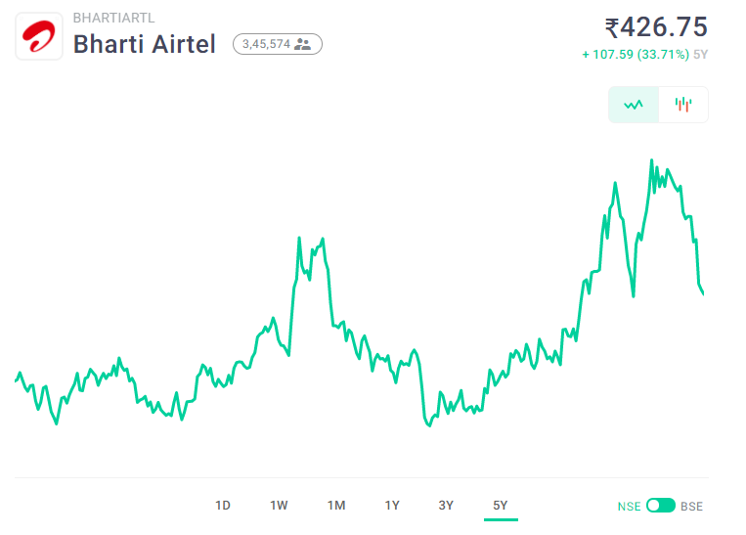
Stocks – Bharti Airtel
Organization: Bharti Airtel
Founded Year: 1995
Managing Director: Gopal Vittal
The current market capitalization stands ₹ 2,32,816 Cr.
The company is listed on the Bombay Stock Exchange (BSE) with the BSE code as 532454 and also listed on National Stock Exchange (NSE) with NSE code as BHARTIARTL

Slide 7
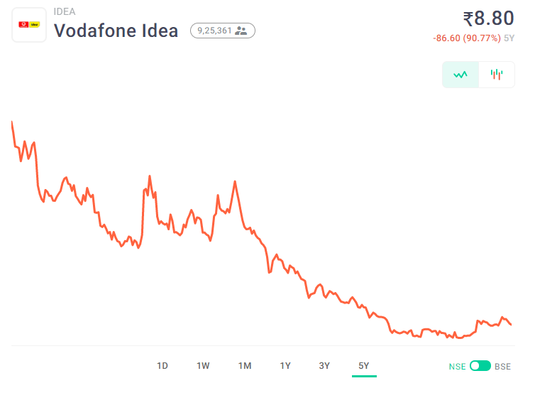
Stocks – Vodafone Idea
Organization: Vodafone Idea Ltd
Founded Year: 1995
Managing Director: Ravinder Takkar
The current market capitalization stands ₹ 25,287 Cr.
The company is listed on the Bombay Stock Exchange (BSE) with the BSE code as 532822 and also listed on National Stock Exchange (NSE) with NSE code as IDEA

Slide 8
Data Understanding and Analysis
The Data at a Glance
The Process
1230
Unique Stock Details
The collected data gathered are both defined and accurate.
Preparing the data into a suitable form for further analysis by removing unwanted symbols, null values. etc.
Examine the structure of variables.
Visual Exploratory Analysis to spot trends within variables.
Decide most relevant variables to be included in the pricing section as part of the modeling process.
2
Types of Data: Numerical and Object
6 1
Numerical Object
2015-2020
Historical data for the year
7
Different variables used

Slide 9
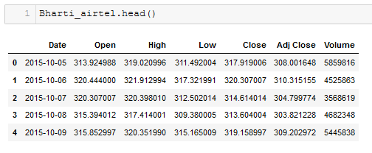
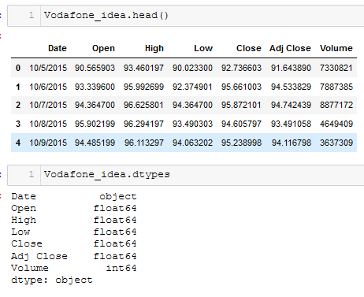
Dataset
Bharti Airtel
Vodafone Idea

Slide 10
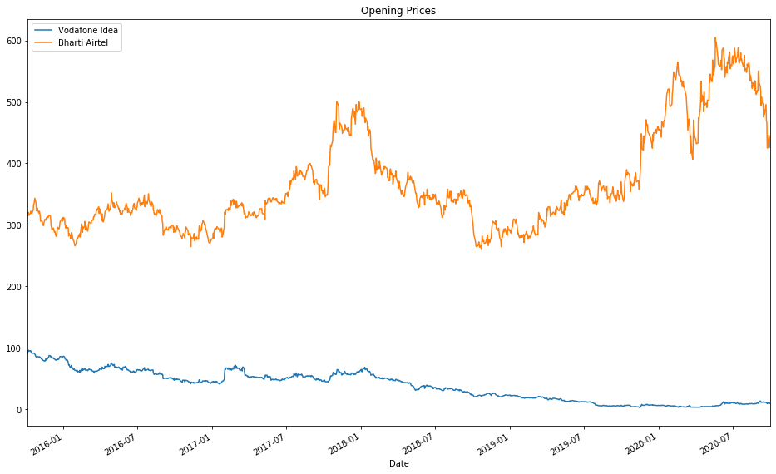
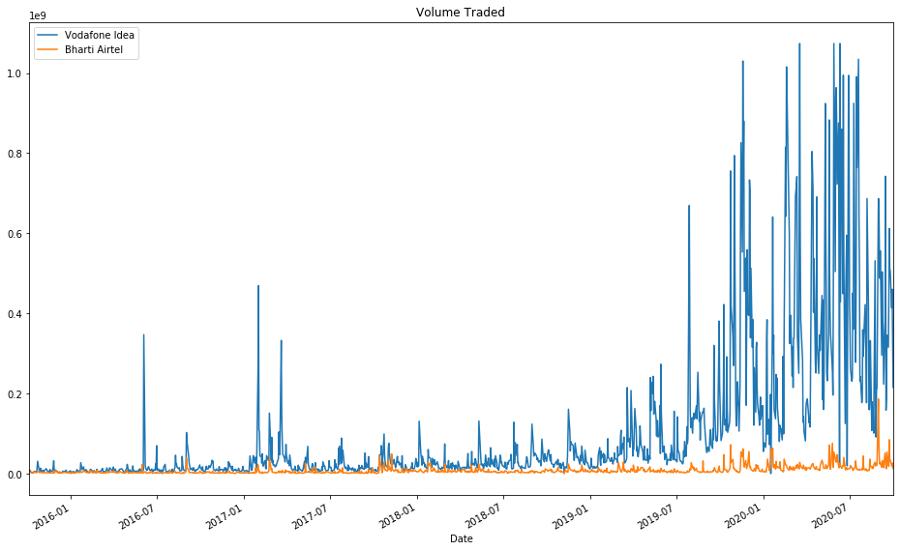
Stock Market Data Visualization
The trading 'Opening Price' for Bharti Airtel have been increasing over time with a positive trend.
The trading 'Opening Price' for Vodafone Idea has a negative trend.
Bharti Airtel is not being traded at the same volume as VI.
Vodafone Idea company there multiple very high peaks in the last one year.

Slide 11
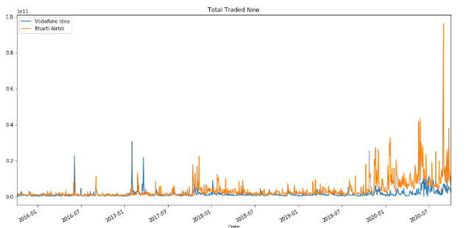
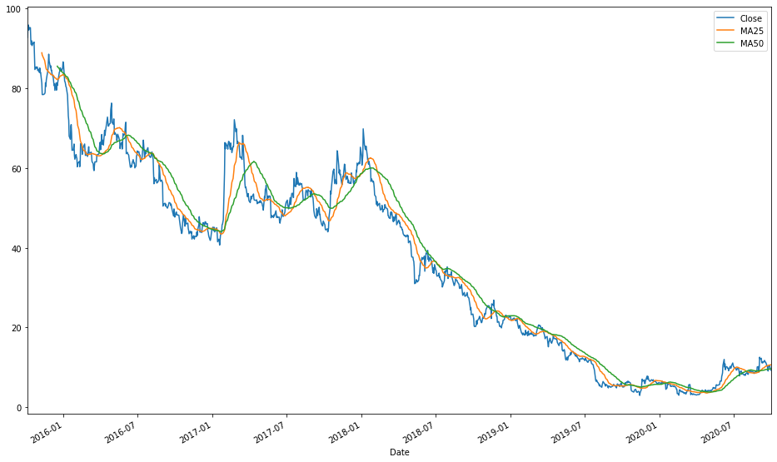
Stock Market Data Visualization
Another useful visual is the visual of the total volume that was traded
To make it more precise, I would use average prices instead of the price at the opening

Slide 12
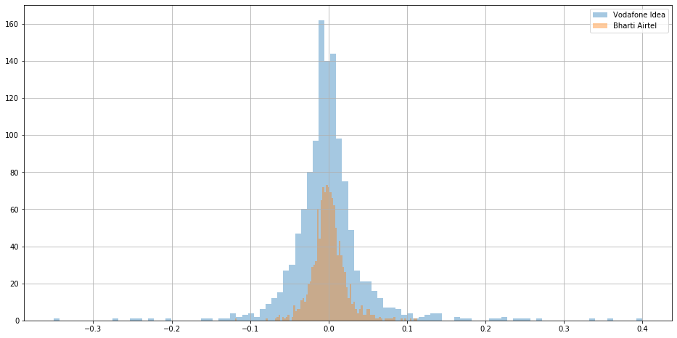
Stock Market Data Visualization
Moving Average (MA) is widely used in technical analysis to smooth out the price by taking out the "noise" from random short-term price changes. Since it is based on historical prices, it is a lagging or trend-following indicator.

Slide 13
TIME SERIES
Time Series is a collection of data points collected at constant time intervals. Time series is thought to consist of three systematic components including level, trend, seasonality, and one non-systematic component called noise.
These components are defined as follows:
• Level: The average value in the series.
• Trend: The increasing or decreasing value in the series.
• Seasonality: The repeating short-term cycle in the series.
• Noise: The random variation in the series.

Slide 14
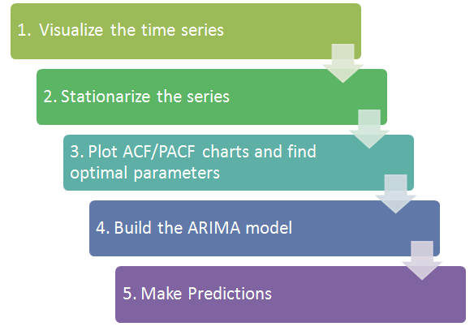
Steps for Time Series Analysis

Slide 15
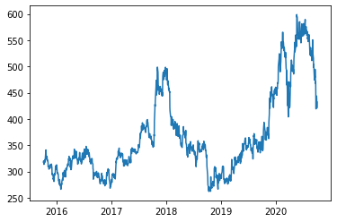
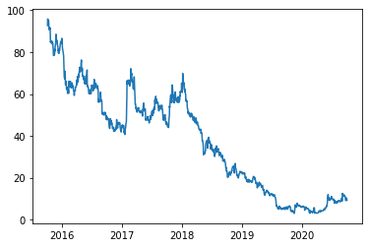
1. Visualise the data
Bharti Airtel
Vodafone Idea

Slide 16
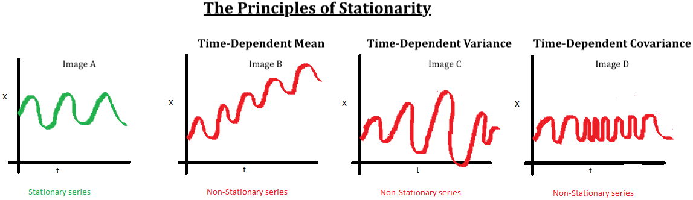
2. STATIONARITY
A stationary series is one in which the properties – mean, variance and covariance, do not vary with time.
But why is it important? Most of the TS models work on the assumption that the TS is stationary. Intuitively, we can say that if a TS has a particular behavior over time, there is a very high probability that it will follow the same in the future.
The Principles of Stationarity

Slide 17
2. Method to check stationarity
1. Plot the data
Bharti Airtel
Vodafone Idea

Slide 18
2. Plotting Rolling Statistics:
We can plot the moving average or moving variance and see if it varies with time. By moving average/variance it mean average/variance of the last certain period. E.g. last 12 months.
3. ADF (Augmented Dickey-Fuller) Test
The Dickey-Fuller test is one of the most popular statistical tests. It can be used to determine the presence of unit root in the series, and hence help us understand if the series is stationary or not. The null and alternate hypothesis of this test is:
Null Hypothesis: The series has a unit root (value of a =1)
Alternate Hypothesis: The series has no unit root.
If we fail to reject the null hypothesis, we can say that the series is non-stationary. This means that the series can be linear or difference stationary.
If both mean and standard deviation are flat lines(constant mean and constant variance), the series becomes stationary.

Slide 19
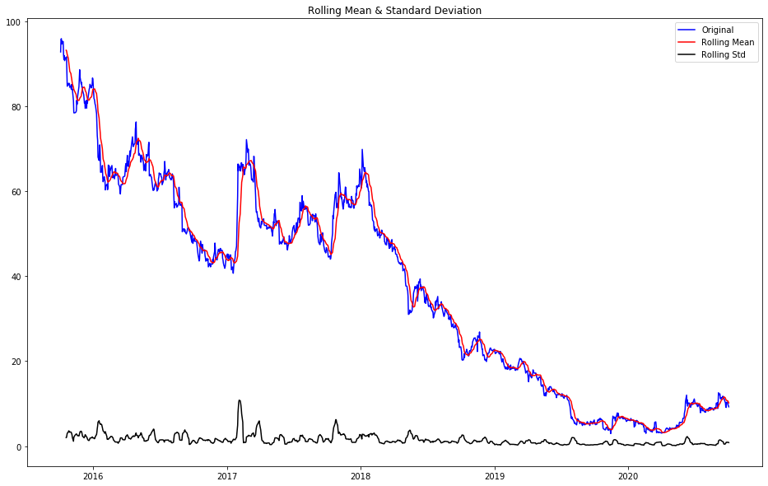
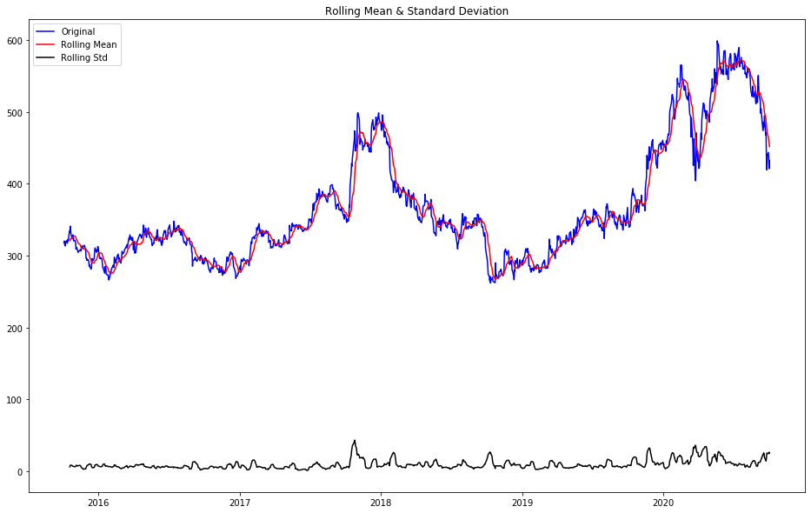
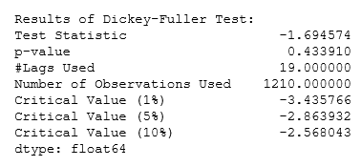
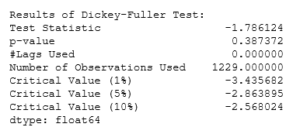
Test for stationarity
Vodafone Idea
Bharti Airtel
We see that the p-value is greater than 0.05 so we cannot reject the Null hypothesis.
Also, the test statistics is greater than the critical values. So, the data is non-stationary.

Slide 20
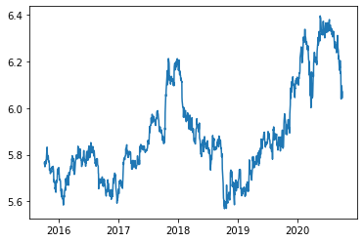
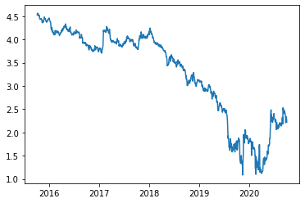
3. Making a Time Series Stationary
Transformation: Transformations are used to stabilize the non-constant variance of a series. Common transformation methods include power transform, square root, and log transform. Here we have used Log Transformation.
Bharti Airtel
Vodafone Idea

Slide 21
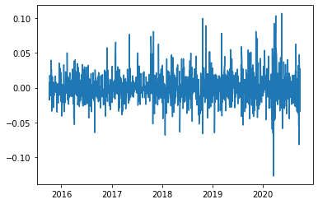
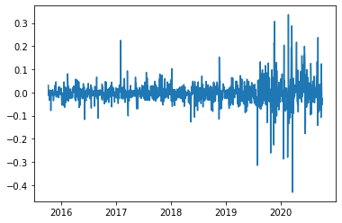
Differencing: In this method, we compute the difference of consecutive terms in the series. Differencing is typically performed to get rid of the varying mean.
Mathematically, differencing can be written as:
y_{t}‘ = y_{t} – y_{(t-1)}
where y_{t} is the value at a time t
Bharti Airtel
Vodafone Idea
Stock Market Analysis – Vodafone Idea and Bharti Airtel

Slide 22
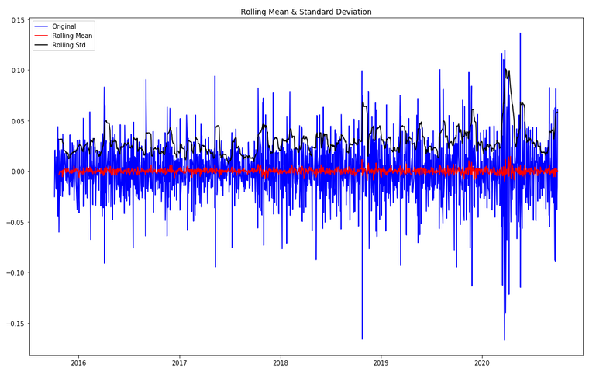
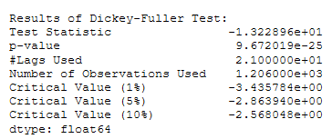
Differencing: Bharti Airtel
Stock Market Analysis – Vodafone Idea and Bharti Airtel

Slide 23
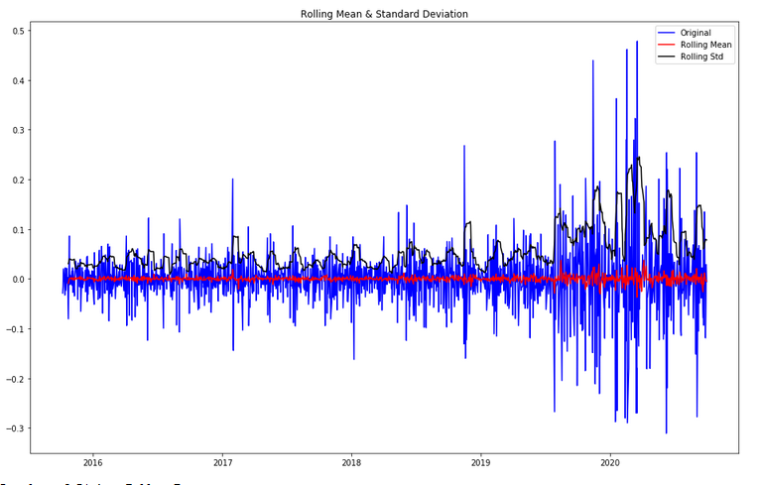
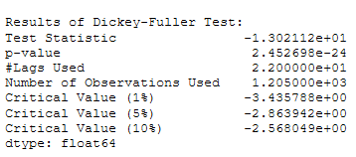
Differencing: Vodafone Idea
Stock Market Analysis – Vodafone Idea and Bharti Airtel

Slide 24
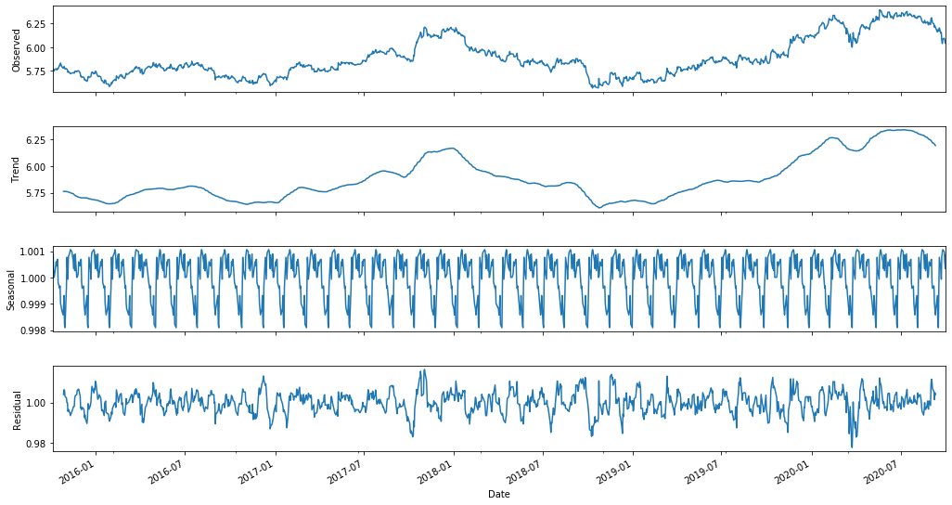
ii) Decomposing: In this approach, both trend and seasonality are modeled separately and the remaining of the series is returned.
Decomposing: Bharti Airtel
Stock Market Analysis – Vodafone Idea and Bharti Airtel

Slide 25
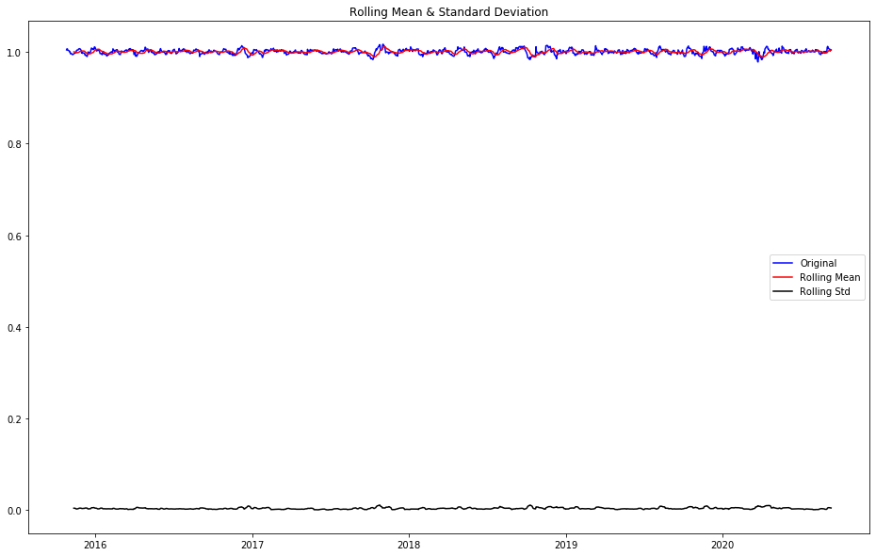
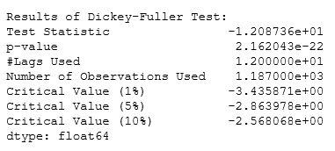
Stock Market Analysis – Vodafone Idea and Bharti Airtel

Slide 26
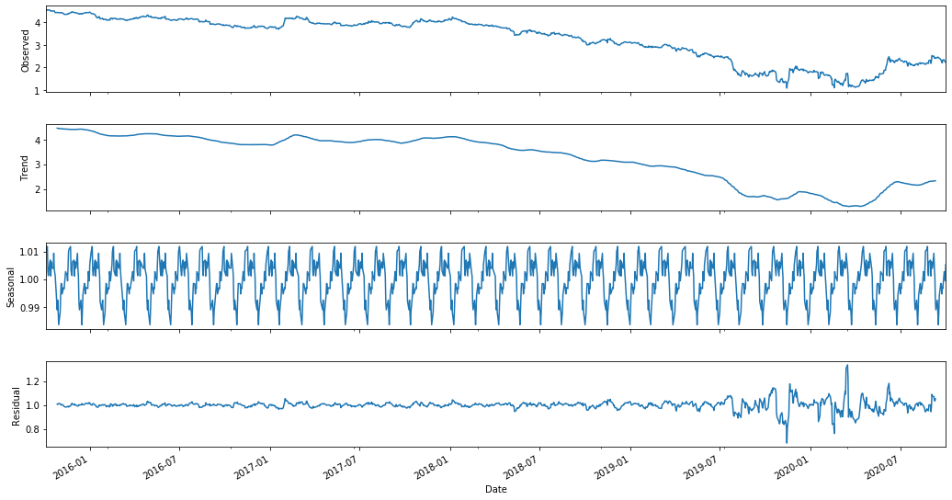
Decomposing: Vodafone Idea
Stock Market Analysis – Vodafone Idea and Bharti Airtel

Slide 27
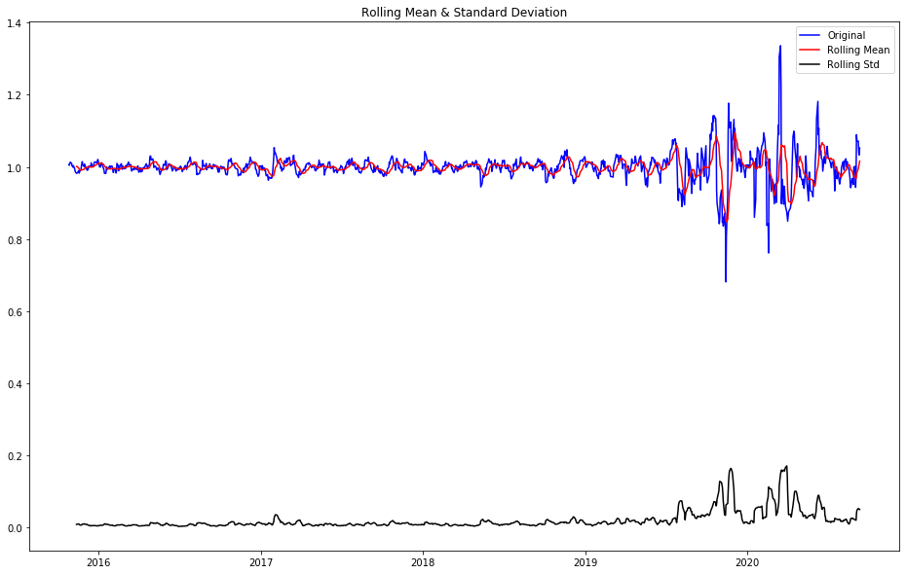
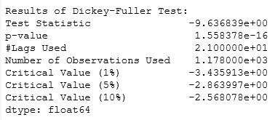
Stock Market Analysis – Vodafone Idea and Bharti Airtel

Slide 28
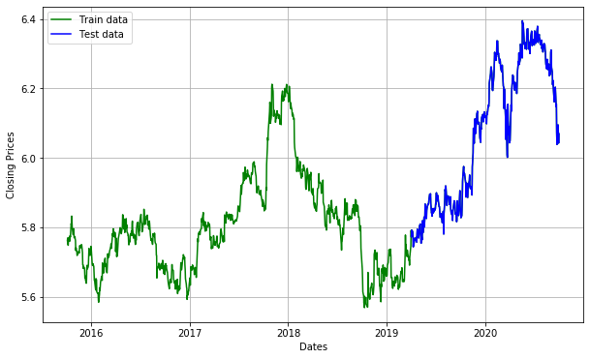
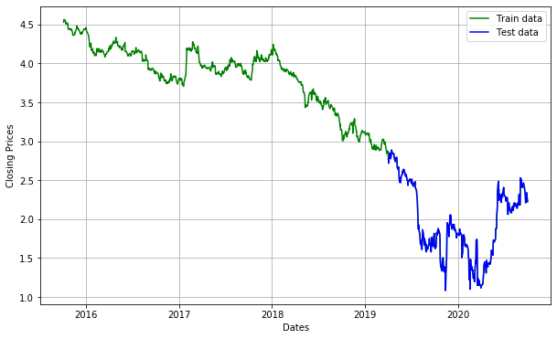
iv) Data Splitting: Split the data into train and testing set
Bharti Airtel
Vodafone Idea
Stock Market Analysis – Vodafone Idea and Bharti Airtel

Slide 29
ARIMA Model
ARIMA is an acronym that stands for AutoRegressive Integrated Moving Average.
An ARIMA model is a class of statistical models for analyzing and forecasting time series data.
Auto ARIMA: Automatically discover the optimal order for an ARIMA model. The auto_arima function seeks to identify the most optimal parameters for an ARIMA model, and returns a fitted ARIMA model. This function is based on the commonly-used R function, forecast::auto.arima.

Slide 30
Parameters of ARIMA Model
1.Number of AR (Auto-Regressive) terms (p): AR terms are just lags of dependent variable. For instance if p is 5, the predictors for x(t) will be x(t-1)….x(t-5).
2.Number of MA (Moving Average) terms (q): MA terms are lagged forecast errors in prediction equation. For instance if q is 5, the predictors for x(t) will be e(t-1)….e(t-5) where e(i) is the difference between the moving average at I’th instant and actual value.
3.Number of Differences (d): These are the number of nonseasonal differences, i.e. in this case we took the first order difference. So either we can pass that variable and put d=0 or pass the original variable and put d=1. Both will generate same results.
An importance concern here is how to determine the value of ‘p’ and ‘q’.
We use ACF and PACF to determine these numbers.

Slide 31
ACF and PACF
1. Autocorrelation Function (ACF): It is a measure of the correlation between the TS with a lagged version of itself. For instance at lag 5, ACF would compare series at time instant ‘t1’…’t2’ with series at instant ‘t1-5’…’t2-5’ (t1-5 and t2 being end points).
2. Partial Autocorrelation Function (PACF): This measures the correlation between the TS with a lagged version of itself but after eliminating the variations already explained by the intervening comparisons. E.g. at lag 5, it will check the correlation but remove the effects already explained by lags 1 to 4.
Stock Market Analysis – Vodafone Idea and Bharti Airtel

Slide 32
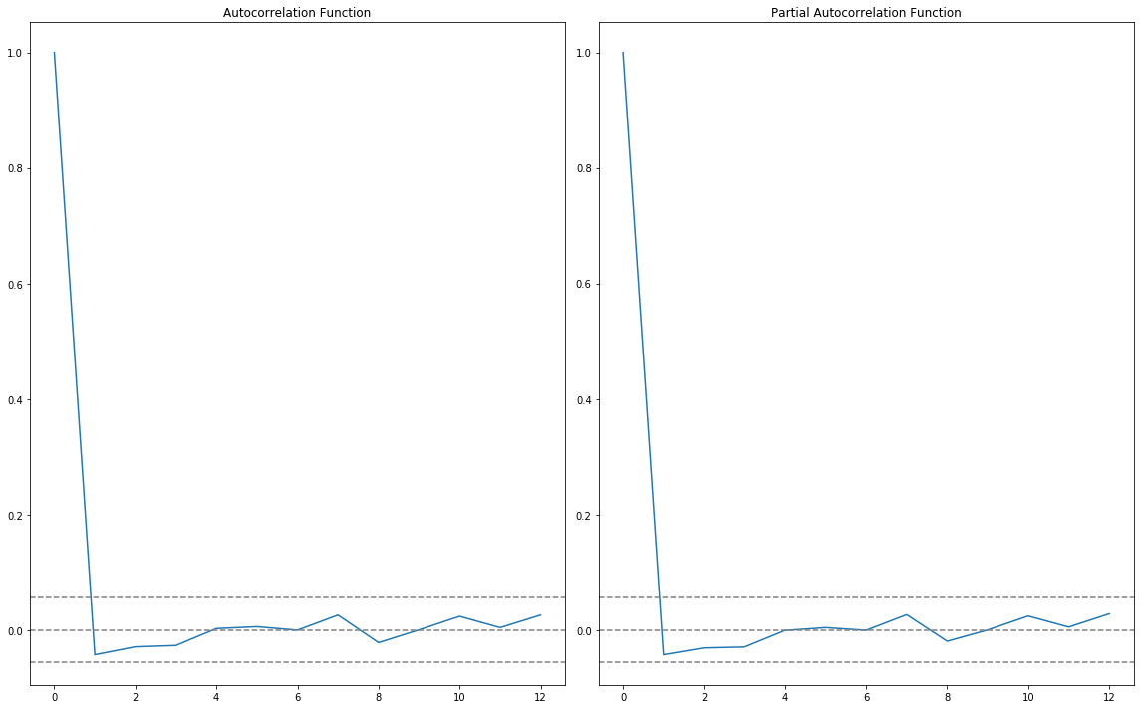
Plot : Bharti Airtel
In this plot, the two dotted lines on either sides of 0 are the confidence intervals. These can be used to determine the ‘p’ and ‘q’ values as:
1. p – The lag value where the PACF chart crosses the upper confidence interval for the first time. If you notice closely, in this case p=1
2. q – The lag value where the ACF chart crosses the upper confidence interval for the first time. If you notice closely, in this case q=1
Stock Market Analysis – Vodafone Idea and Bharti Airtel

Slide 33
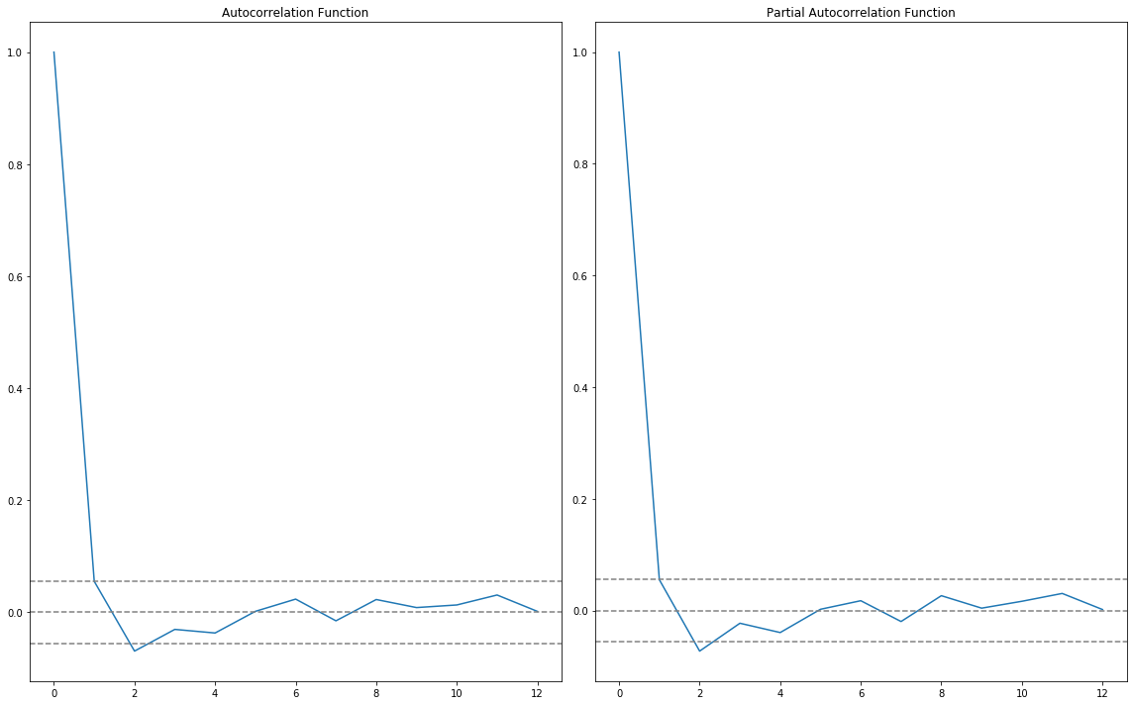
Plot : Vodafone Idea
In this plot, the two dotted lines on either sides of 0 are the confidence intervals. These can be used to determine the ‘p’ and ‘q’ values as:
3. p – The lag value where the PACF chart crosses the upper confidence interval for the first time. If you notice closely, in this case p=1
4. q – The lag value where the ACF chart crosses the upper confidence interval for the first time. If you notice closely, in this case q=1
Stock Market Analysis – Vodafone Idea and Bharti Airtel

Slide 34
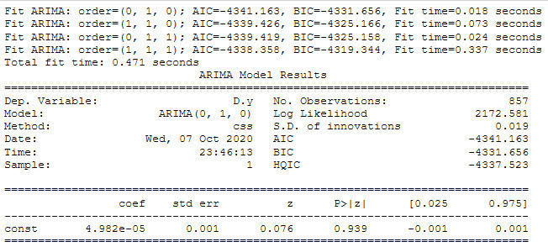
auto_arima() uses a stepwise approach to choose the best combination of the p, d, q values for the model which has the lowest AIC.
Here, we can see that auto_arima creates multiple models with difference combinations of the hyperparameters and gives us the parameters which gives us the lowest AIC.
AIC (Akaike Information Criterion) and BIC (Bayesian Information Criterion) values are estimators to compare models. The lower these values, the better is the model.
Plot : Bharti Airtel
Stock Market Analysis – Vodafone Idea and Bharti Airtel

Slide 35
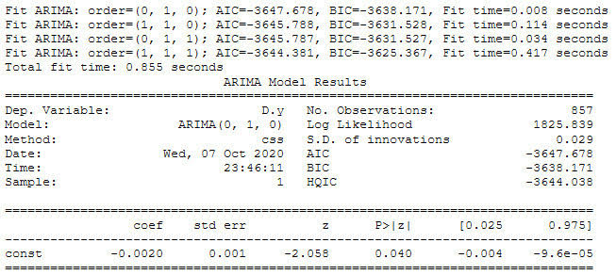
Plot : Vodafone Idea
Stock Market Analysis – Vodafone Idea and Bharti Airtel

Slide 36
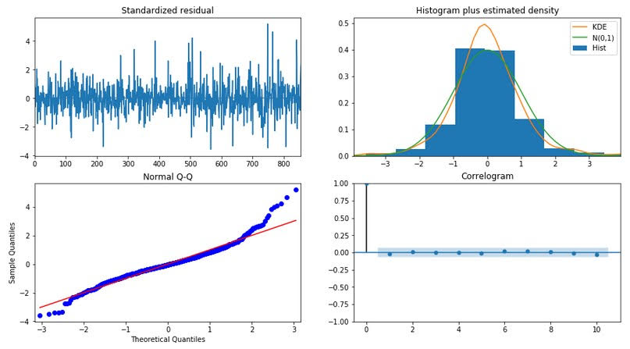
The residual plots from Auto ARIMA for Bharti Airtel
Stock Market Analysis – Vodafone Idea and Bharti Airtel

Slide 37
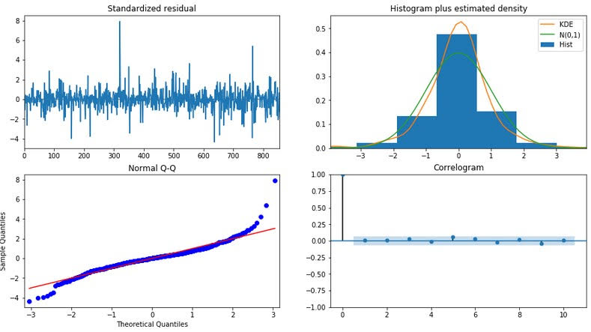
The residual plots from Auto ARIMA for Vodafone Idea
Stock Market Analysis – Vodafone Idea and Bharti Airtel
Stock Market Analysis – Vodafone Idea and Bharti Airtel

Slide 38
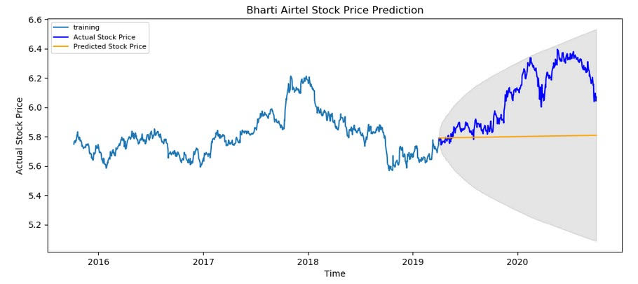
Forecast Stock Price on the test dataset keeping 95% confidence level.
Stock Market Analysis – Vodafone Idea and Bharti Airtel
Stock Market Analysis – Vodafone Idea and Bharti Airtel

Slide 39
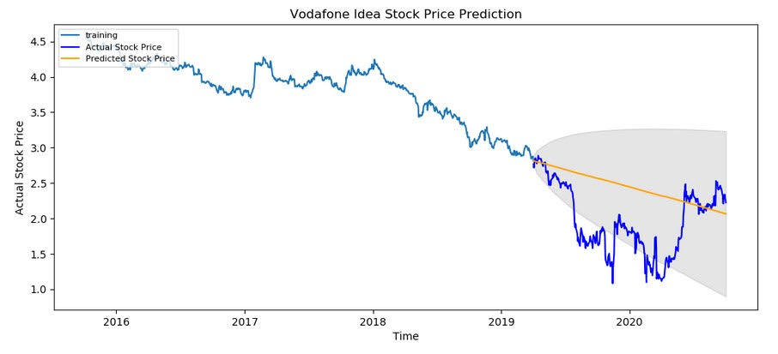
Forecast Stock Price on the test dataset keeping 95% confidence level.
Stock Market Analysis – Vodafone Idea and Bharti Airtel
Stock Market Analysis – Vodafone Idea and Bharti Airtel

Slide 40


Performance Report
Bharti Airtel
Around 4.4% MAPE(Mean Absolute Percentage Error) implies the model is about 95.6% accurate in predicting the test set observations.
Vodafone Idea
Around 32% MAPE(Mean Absolute Percentage Error) implies the model is about 68% accurate in predicting the test set observations.
Stock Market Analysis – Vodafone Idea and Bharti Airtel

Slide 41
Conclusion and Insights
A good way to improve our predictions would be to use Deep Learning methods like LSTM which is able to store past information that is important and forget information that is not needed.
There are multiple factors involved in stock price predictions: Physical factors, Psychological factors, rational vs. irrational behaviors etc.
All of these factors combine and make the stock prices exceptionally volatile and very difficult to predict with any accuracy.

Slide 42
THANK YOU
PRESENTED BY:
Rakhee Singh
Gladwin Gracias
Noella Joy

